Slide 1
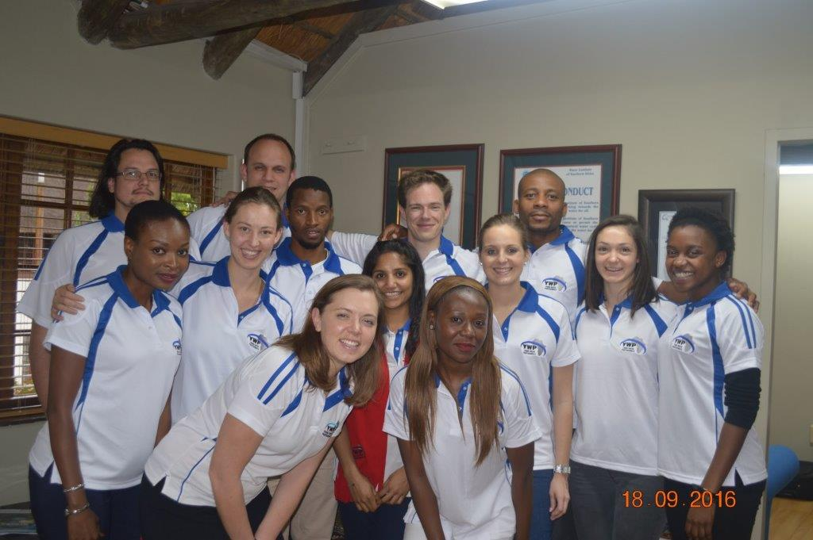

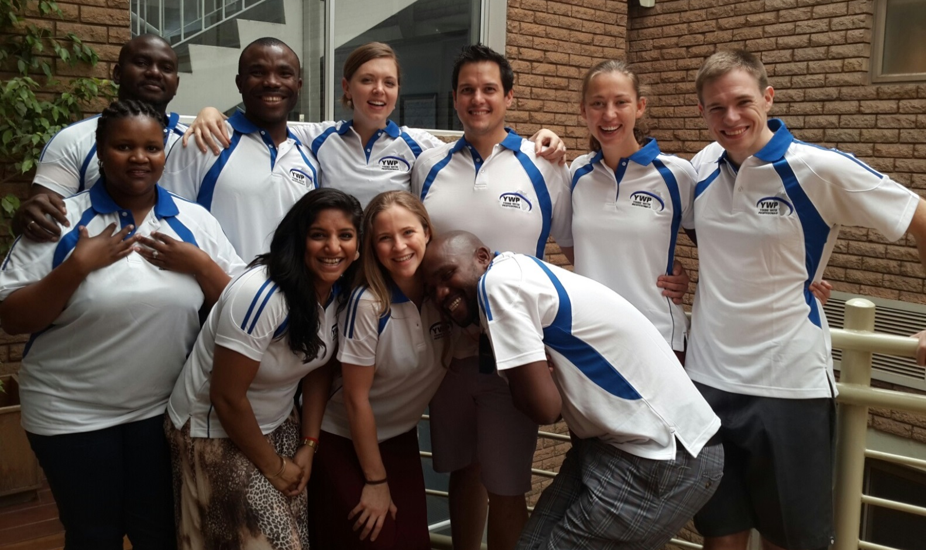


South African Young Water Professionals (YWP-ZA)
22 march 2017

Slide 2

Who are the YWP-ZA?

Slide 3
Non-profit company: As a division of WISA incorporated for public benefit.
Volunteers: All 1400 members volunteer their time.
Water professionals: Students but mostly early career professionals, mid-career professionals.
Inclusive: All residents of South Africa.
Restriction: Under the age of 35 or less than five years in the water sector.
Notes:
YWP-ZA was founded in 2008

Slide 4
Provincial Chapters
YWP-ZA LIMPOPO
YWP-ZA EASTERN CAPE
YWP-ZA FREE STATE
YWP-ZA GAUTENG
YWP-ZA KWA-ZULU NATAL
YWP-ZA MPUMALANGA
YWP-ZA WESTERN CAPE
YWP-ZA NORTHERN CAPE

Slide 5
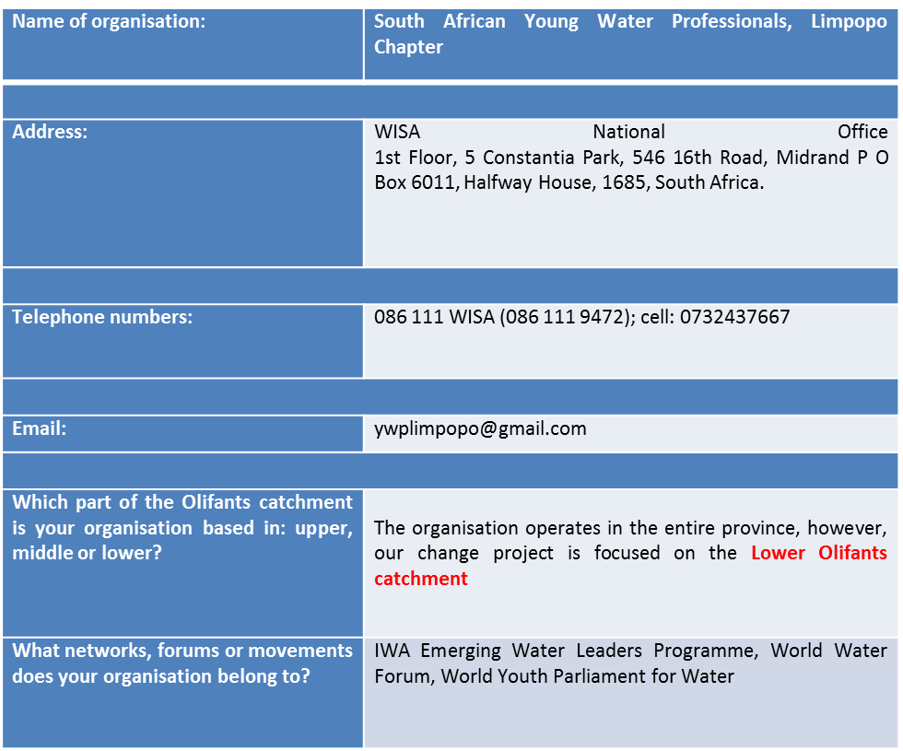
Provincial Chapters

Slide 6
CHANGING PRACTICE PROJECT
Our changing practice lies in developing local resilience to dwindling natural resources which includes for land, water, and energy.
Water, land and energy nexus as a natural resources is highly threatened with the intensification of anthropogenic activities and climate change.
This project aims at identifying key sources of water quality deterioration in the lower reaches of the Olifants River Catchment as a result of water, land, and energy usage upstream of the catchment.

Slide 7
CHANGING PRACTICE PROJECT
Where it is, what are the challenges in that area, how long you have been working there and what your role is in the area/community, what is the landscape like, what is the river like?

Slide 8
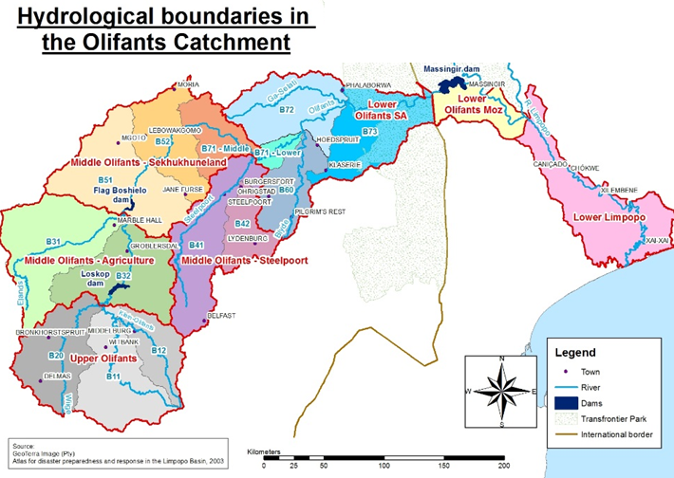
THE OLIFANTS RIVER CATCHMENT

Slide 9
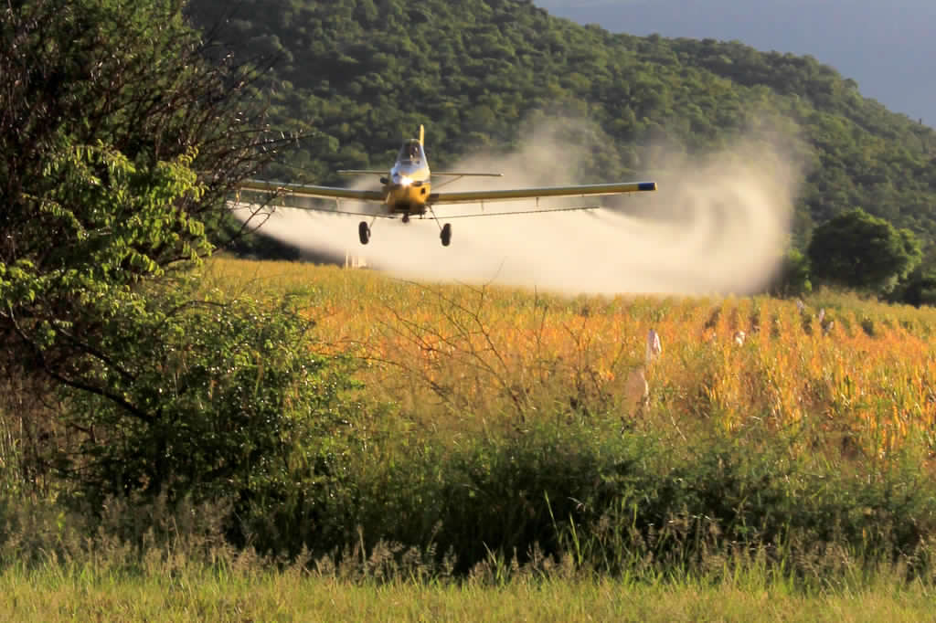
CHANGING PRACTICE PROJECT
What is happening? Spraying of pesticides on open agricultural land
If there are people in the photograph, who are the people, what are they doing?
How does this picture relate to your Change Project? Pesticides pollutes river water through agricultural runoff
Does the picture represent a specific challenge you or others may face? What is this challenge? OR does it represent how you are responding to the challenge? If so, what is your response? It represents a challenge, agricultural runoff is a major problem, not only for the olifants catchment, but in any region of the world where agriculture is being practiced. Therefore, there is a need to move towards sustainable ways of practicing agriculture.

Slide 10
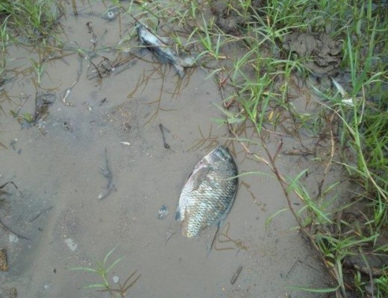
CHANGING PRACTICE PROJECT
What is happening? Dead fish as a results of pollution in the lower Olifants River Catchment
If there are people in the photograph, who are the people, what are they doing?
How does this picture relate to your Change Project? River water contamination is one of the focal point of my change project and this proves that there is already an existing problem in the catchment that need to be addressed.
Does the picture represent a specific challenge you or others may face? What is this challenge? OR does it represent how you are responding to the challenge? If so, what is your response? It represents a challenge, Companies discharge hazardous waste unlawfully into river system, and for example the fish in the picture died of contamination caused by Bosveld Phosphates (Pty) discharges into the river in the Phalaborwa area of the Olifants. Therefore, there is a need to monitor what mining and processing plants are discharging into river systems.

Slide 11
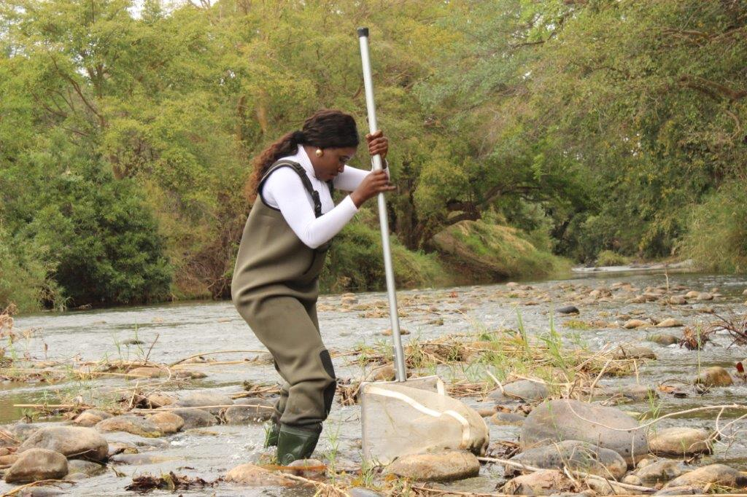
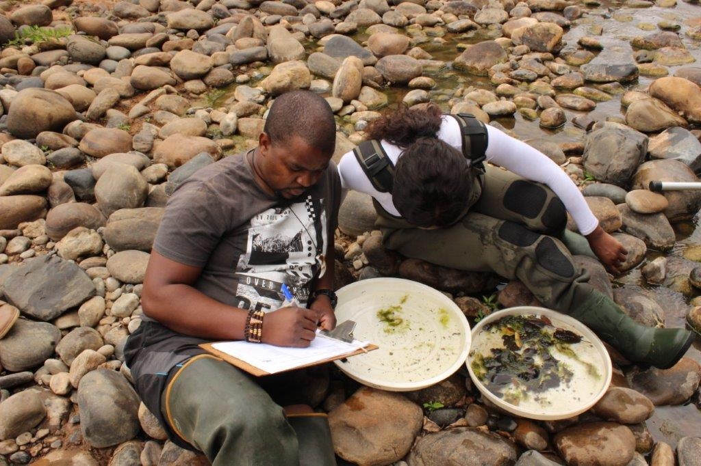
CHANGING PRACTICE PROJECT
What is happening? Biomonitoring in the lower catchment area of the Olifants River
If there are people in the photograph, who are the people, what are they doing? Thabo and Mulweli (YWP-Limpopo) from AWARD
How does this picture relate to your Change Project? Biomonitoring is an indicator of river health.
Does the picture represent a specific challenge you or others may face? What is this challenge? OR does it represent how you are responding to the challenge? If so, what is your response? This responds to the challenge of water contamination in the lower catchment:::

Slide 13
STAY IN TOUCH
Sign up to our newsletter for event updates, job openings and upcoming conferences:
www.ywp-za.org
Our contact details: http://www.ywp-za.org/contact.html
Facebook as YWP ZA
Twitter @YWPZA
Github https://github.com/arreyves/Changing-Practice-Project-YWP-Limpopo

